Slide 1

Predicting Hit Songs using Repeated Chorus
ML Project Group 14

Slide 2
Acknowledgement
We would like to express our special thanks of gratitude to our mentor Dr. Bharavi Mishra, for their able guidance and support throughout the project.
Ansh Jain - 19ucs059
Neeraj Kumar Singhal - 19ucs029
Naresh Kumawat - 19ucs046

Slide 3
Table of Contents.
Introduction
Dataset & Features
Data Exploration
Methods
Evaluation
Conclusion
1
2
3
4
5
6

Slide 4
Introduction
Songwriters and producers have long believed that writing a successful hook is what makes a song popular.
So we have examined the myth by creating a data set of courses from popular artists and applied 8 Machine Learning techniques to predict the popularity purely based on the audio features extracted from a 15s chorus.

Slide 5
DataSet and Features
There is no publicly available dataset for hooks of songs. Therefore, we have to build the following data pipeline to prepare the data and features
Collect the names of popular songs and unpopular songs from the same artists the from Billboard.com.
Download the full songs from Youtube using youtube-dl.
Extract the repeated chorus using pychorus.
Extract the audio features of the hooks using librosa.

Slide 6
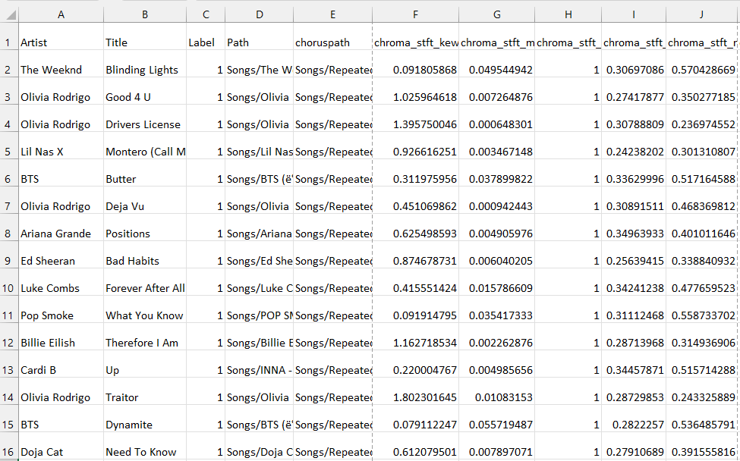
Final DataSet
The dataset in this final report has a 751 × 518 audio feature matrix.

Slide 7
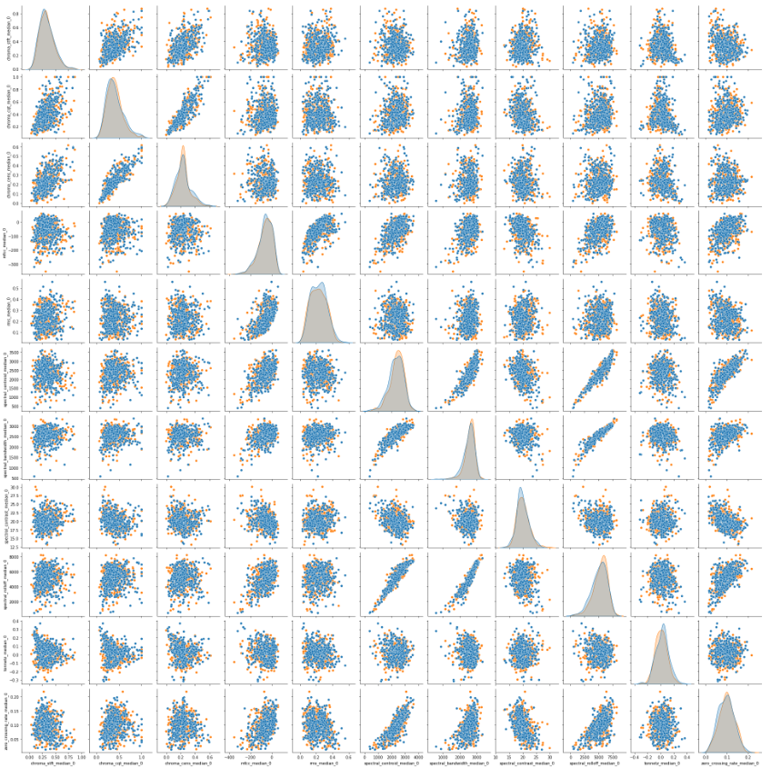
Data Exploration
Pair Scatter Plot
The signal to noise ratio is quite high as there is no clear separation between any pair of the audio features between the response class.

Slide 8
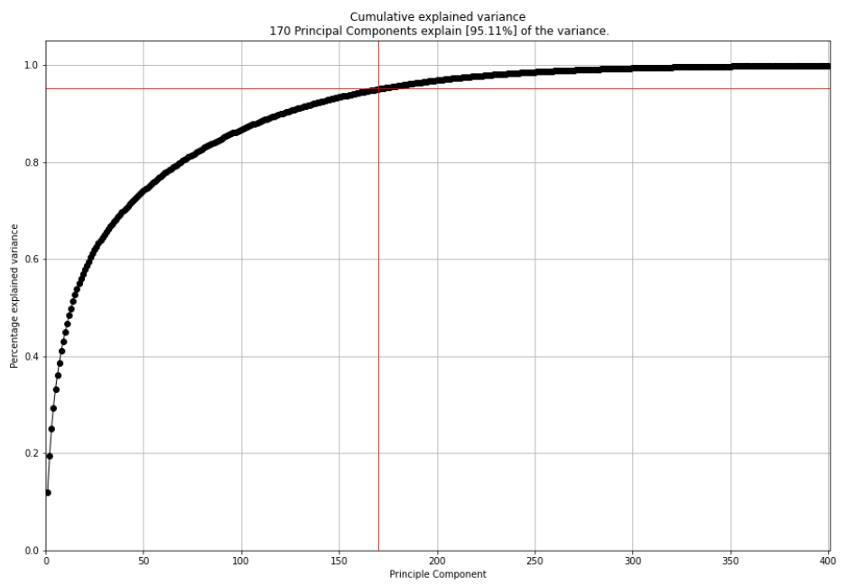
Data Exploration
Principal Component Analysis
We got to know that 95% of the variance is due to 170 Principal Components.
So we applied PCA projection to reduce the dimensionality.
After applying PCA, we tried Pair Scatter Plot analyses but there was no clear separation between classes.

Slide 9
Methods
We have applied several models to predict if the song is hit or not
Logistic Regression
Linear Discriminant Analysis (LDA)
SVM
Linear SVM
Polynomial SVM
RBF SVM
Random Forest (RF)
Gradient Boosting Machine(GBM)
Decision Tree
K Nearest Neighbours (kNN)

Slide 10
Methods
For applying the models, we have used 80% data for training and 20% data for testing.
(80 : 20 training - testing data)
We have also applied 5-fold Cross Validation (CV) for all candidate learning algorithms

Slide 11
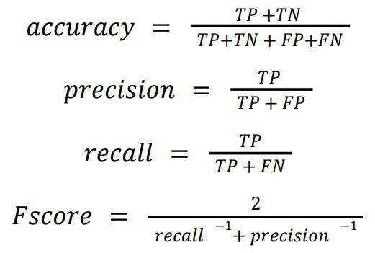
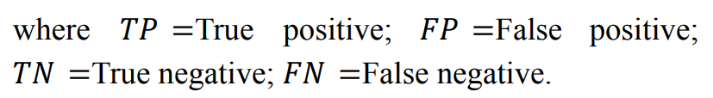
Evaluations
The score functions are classically defined as follows
We have evaluated four metrics for model comparison during testing and training.
F1
Accuracy
Precision
Recall

Slide 12
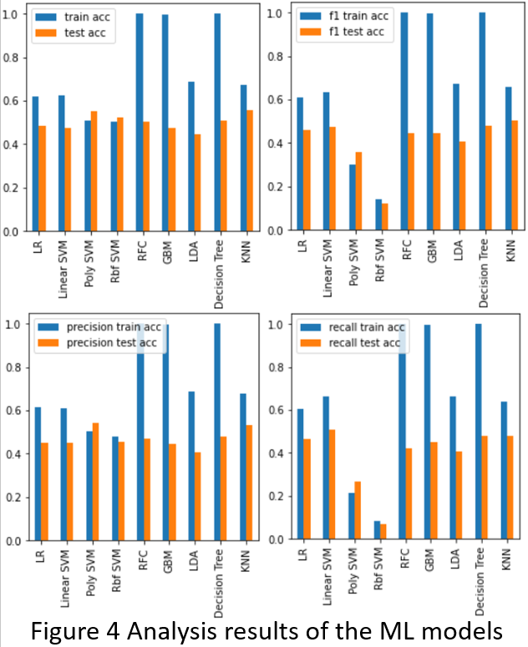

Slide 13
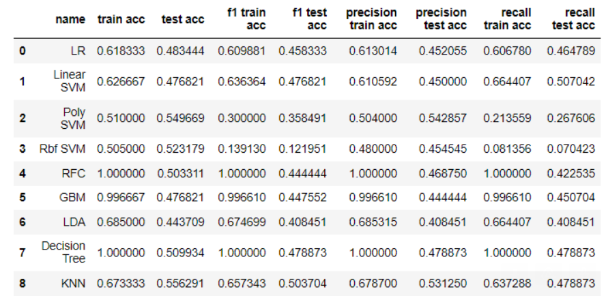

Slide 14
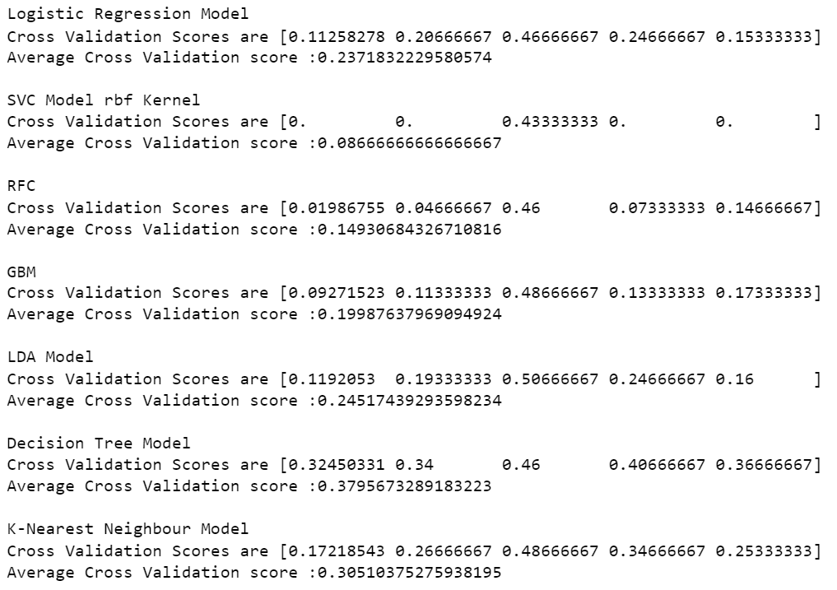
Evaluation
5 Fold crossover scores

Slide 15
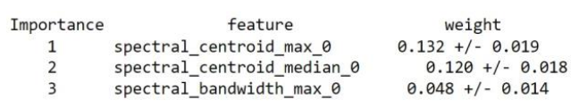
K Nearest neighbors Deep Dive
We used permutation tests to analyse the feature importance test and develop intuition for error analysis.

Slide 16
Conclusion
The models performed better than random guessing but the scores are very less. None of the model give us score more than 50%. We could have evaluated more but due to resource and time constraint we restrict our observations to these models only.
The poor performance ratings in all models suggest that the song's success is related to far more external influences than the repeated chorus only.

Slide 17
Thank you!
Do you have any questions?
Group-14

